Slide 1
PHYSIOLOGY OF THE THYROID GLAND Dr.Deepa.G.S Associate professor Dept of Physiology

Slide 2
Thyroid Gland
Only visible endocrine gland since it is located in
front of trachea
Largest endocrine gland which weighs about 15-25
gm
Thyroid secretion stored extracellularly in the
colloid
Contains 95% Iodine content of our body
Only tissue that can oxidize iodide to iodine
Thyroid stores enough thyroid hormones to
maintain euthyroid state for about 3 months without
hormone synthesis

Slide 3
Primary functions of thyroid gland
Secretes T3 and T4 which maintain the level of metabolism in tissues that is optimal for their normal function
Secrets calcitonin that regulates circulating levels of calcium

Slide 4
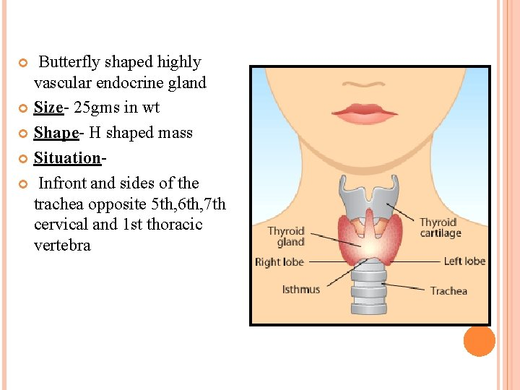
Thyroid Gland
https://slidetodoc.com/thyroid-gland-and-parathyroid-thyroid-gland-introduction-situation/

Slide 5
Thyroid Gland

Slide 6
HISTOLOGY
The lobes of the thyroid contain many hollow, spherical structure called follicles,(3 million) which are the functional units of the thyroid gland.
Follicl is surrounded by rich capillay plexus
Interspersed between the follicles are C cells (parafollicular cells), which secrete calcitonin.
Each follicle is filled with a thick sticky substance called colloid.

Slide 7
HISTOLOGY
The major constituent of colloid is a large glycoprotein called thyroglobulin.
Unlike other endocrine glands, which secretes their hormones once they are produced, the thyroid gland stores considerable amount of the thyroid hormones in the colloid until they are needed by the body.

Slide 8
Hormones of thyroid gland
The principal ones being
Triiodothyronine (T₃) – 9-10%
Thyroxine or tetraiodothyronine (T₄)-90%
These hormones regulate the growth and rate of function of many other systems in the body.
The thyroid also produces Calcitonin, which plays a role in calcium homeostasis.

Slide 9
Hormones of thyroid gland
Chemistry
T4 and T3 are iodine-containing derivatives of amino acid tyrosine.
Potency
The potency of T3 is four times more than that of T4
Duration of Action
Duration of T4 action is four times more than T3 action.
This is because T3 has less affinity for plasma proteins and
combines loosely with them, so that it is released quickly.
T4 has more affinity and strongly binds with plasma proteins, so
that it is released slowly.
Therefore, T3 acts on the target cells immediately and T4 acts
slowly.

Slide 10
Hormones of thyroid gland
Half-life
Thyroid hormones have long half-life. T4 has a long halflife
of 7 days. Half-life of T3 is varying between 10 and
24 hours.
Rate of Secretion
Thyroxine = 80 to 90 μg/day
Tri-iodothyronine = 4 to 5 μg/day
Reverse T3 = 1 to 2 μg/day.
Plasma Level
Total T3 = 0.12 μg/dL
Total T4 = 8 μg/dL.

Slide 11
SYNTHESIS, STORAGE & SECRETION OF THYROID HORMONES
Tyrosine and iodine are essential for synthesis of thyroid hormones.
Both are taken up by the blood from the diet
Iodine is a dietary essential-150mcirogm/day
Hormone synthesis occurs on the thyroglobulin.

Slide 12
SYNTHESIS, STORAGE & SECRETION
Following steps are involved in synthesis, storage and
secretion
Thyroglobulin synthesis
Iodide trapping
Oxidation of iodide
Transport of iodine into follicular cavity
Iodination of tyrosine
Coupling reactions

Slide 13
Thyroglobulin synthesis
https://commons.wikimedia.org/wiki/File:Thyroid_hormone_synthesis.png

Slide 14
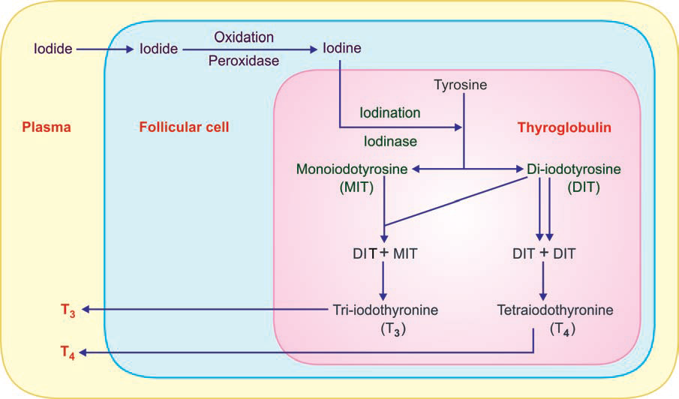
Synthesis of thyroid hormones

Slide 15
Tyrosine + I = Monoiodotyrosine (MIT)
MIT + I = Di-iodotyrosine (DIT)
DIT + MIT = Tri-iodothyronine (T3)
MIT + DIT = Reverse T3
DIT + DIT = Tetraiodothyronine or Thyroxine (T4)

Slide 16
Storage
After synthesis, the thyroid hormones remain in the
form of vesicles within thyroglobulin and are stored for
long period.
Each thyroglobulin molecule contains 5 or 6 molecules of
thyroxine.
There is also an average of 1 tri-iodothyronine molecule
for every 10 molecules of thyroxine.
It is the only endocrine gland that can store its hormone
for a long period of about 4 months.

Slide 17
Release of thyroid hormones
https://www.youtube.com/watch?v=nnfpeTURSIU
https://www.youtube.com/watch?v=-lZihhHdFp4

Slide 18
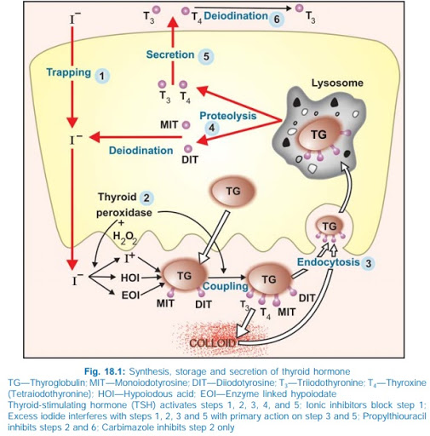
Release of thyroid hormones

Slide 19
Release of thyroid hormone
Approximately, 90% of the hormones released from the thyroid gland initially appear in the form of T4.
However, a majority of the T4 that is secreted from the thyroid gland is subsequently converted to T3.
Small amount of biologically inactive reverse T3 is formed
T3 is 4times more potent in its biologic form than T4 and is the major hormone that interacts with the target cells.

Slide 20
TRANSPORT
Both the hormones are highly lipophilic and once in the blood, immediately bind to proteins:
Thyroid hormone specific protein- thyroxine binding globulin (70-80%)
Thryroxine binding prealbumn
Albumin
Less than 0.1% of T4 and 1% of T3 are in unbound form.
These free T4 and T3 compounds are biologically active, and it is these components that produce the effects of the thyroid hormones on peripheral tissues and on the pituitary feedback mechanism.

Slide 21
Transport
Total plasma – T4 -8micro g/dl
T3 – 0.15 micro g/dl
T4
More bound to TBG
99.8% bound form,0.02% in free form
2ng/dl in free form
Free form is released from bound form according to the need
T3 is continously replenished from T4 which act as areservoir
T3
Bound largely to albumin
99.8% in bound form
0.2% free form

Slide 22
T3 is more active than T4 because of the following reasons
More in free form,less tightly bound to plasma proteins
Greater affinity to thyroid receptors
Half lifeis 1-3 days and action is rapid
Easily absorbed
Penetrates into the cells and tissue fluids rapidly
Free and bound form can be measured by radioimmunoassay

Slide 23
Metabolism
Degradation of thyroid hormones occurs in muscles,
liver and kidney.
80% of T3 and T4 deiodinated to iodotyronines
1/3 of T4 to T3 by the enzyme deiodinase
Pituitary gland and cerebral cortex have high T3/T4 ratio due to expression of specific deiodinaess
45% of T4 converted to reverse T3
20% of T3 and T4 undergo conjugation in liver to glucoronides and sulphate excreted in bile and intestine undergo hydrolysis

Slide 25
REGULATION OF THRYOID HORMONE SECRETION

Slide 26
REGULATION OF THYROID HORMONE SECRETION

Slide 28
Action on protein metabolism
Protein anabolic –Growth promotion
By Increasing the Translation of RNA.
ii. By Increasing the Transcription of DNA to RNA
iii. By Increasing the Activity of Mitochondria
iv. By Increasing the Activity of Cellular Enzymes
In creaed hormone level can cause catabolism

Slide 29
ACTION ON CARBOHYDRATE METABOLISM
Thyroxine stimulates almost all processes involved in
the metabolism of carbohydrate.
Thyroxine:
i. Increases the absorption of glucose from GI tract
ii. Enhances the glucose uptake by the cells, by accelerating the transport of glucose through the cell membrane
iii. Increases the breakdown of glycogen into glucose
iv. Accelerates gluconeogenesis.
Both hyperglycemic and hypoglycemic effects

Slide 30
ACTION ON FATMETABOLISM
Mobilization of fat from adipose tissues and fat depots.
The mobilized fat is converted into free fatty acid and transported by blood.
Decreases blood cholesterol level due to increased synthesis of LDL receptors in the liver
Increase the synthesis breakdown and excretion of cholesterol
Increase release of cholesterol from liver cells to bile and excreted through feces –reduction in cholesterol

Slide 31
ACTION ON FAT METABOLISM
Thyroxine specifically decreases the cholesterol, phospholipids and triglyceride levels in
plasma.
So, in hyposecretion of thyroxine, the cholesterol
level in plasma increases, resulting in atherosclerosis

Slide 32
ACTION ON VITAMIN METABOLISM
Hepatic conversion of beta carotene to Vit.A ,vit.A to
retinine
Absorption of B-compel.x group of vitamins especially
B12

Slide 33
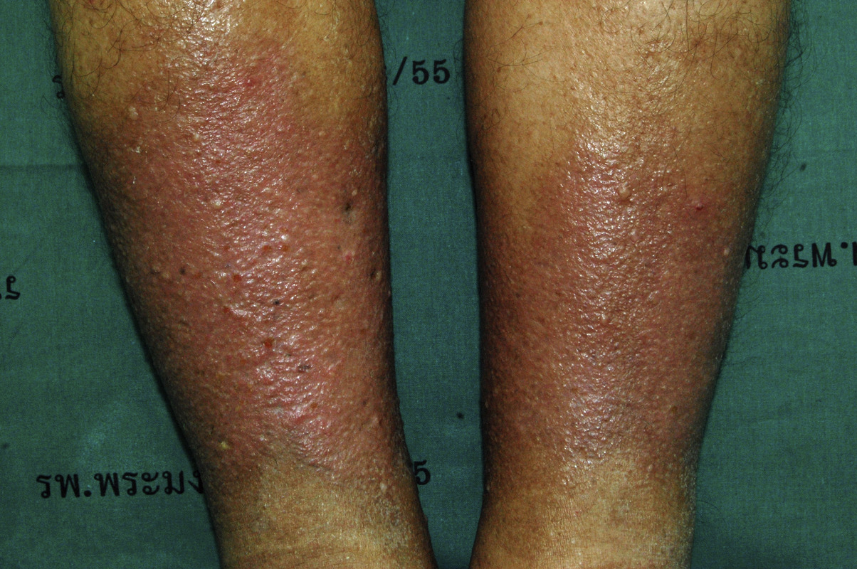
Functions
Fluid and electrolyte metabolism
Distribution of fluid uniformly
Mucoploysaccharide metabolism
Hypothyroidism-Myxoedema

Slide 34
PHYSIOLOGICAL EFFECTS OF THYROID HORMONES
Growth and the nervous system
Effect on growth is manifested mainly in growing children
Thyroid hormone stimulates GH secretion and promotes GH effects
Lack of thyroid hormone → growth retardation but can be reversed
by thyroid replacement therapy
Unlike excess GH, excess thyroid hormone does not produce excessive growth

Slide 35
Growth and differentiation
Brain
Important in promoting growth and development of the brain during fetal and postnatal life
Thyroid hormone deficiency → mental retardation if therapy is not administered days or weeks after birth
Myelination
Arborization
Synaptic development
Bones
Ossification of cartilage and bone growth
Differentiation of tissues during development

Slide 36
On cardiovascular system
↑ heart rate and force of contraction → ↑ CO
↑ the heart’s responsiveness to circulating
catecholamines (permissive action above)
In response to the vasodialator metabolites and heat load → peripheral vasodilation to eliminate generation of extra heat
Systloic pressure increase and diastoilc pressure decreases,pulse pressure increases

Slide 37
ACTION ON RESPIRATION
Thyroxine increases the rate and force of
respiration indirectly.
The increased metabolic rate (caused by
thyroxine) increases the demand for oxygen and
formation of excess carbon dioxide.
These two factors stimulate the respiratory
centers to increase the rate and force of respiration

Slide 38
ACTION ON GASTROINTESTINAL TRACT
Generally, thyroxine increases the appetite and
food intake.
It also increases the secretions and movements
of GI tract.
So, hypersecretion of thyroxine causes diarrhea
and the lack of thyroxine causes constipation

Slide 39
Skeletal muscle
Essential for the normal activity of skeletal muscles.
Slight increase in thyroxine level – muscle work with more vigor
Hypersecretion of thyroxine causes weakness of the muscles due to
catabolism of proteins.
This condition is called thyrotoxic myopathy. The muscles relax very slowly after the contraction.
Hyperthyroidism also causes fine muscular tremor.
Tremor occurs at the frequency of 10 to 15 times per second.
It is due to the thyroxine-induced excess neuronal activity, which controls the muscle.
The lack of thyroxine makes the muscles more sluggish.

Slide 40
PHYSIOLOGICAL EFFECTS OF THYROID HORMONES
Sympathomimetic effect
Sympathomimetic: any action similar to one produced by the sympathetic nervous system
Thyroid hormone ↑ target cell responsiveness to catecholamines (SNS and adrenal)
Thyroid hormones are permissive → ↑ production of specific catecholamine target cell receptors

Slide 41
ACTION ON BODY WEIGHT
Essential for maintaining the body weight.
 ACTION ON BLOOD
Accelerates erythropoietic activity and increases blood volume.
It is one of the important general factors necessary for erythropoiesis.
Polycythemia is common in hyperthyroidism.

Slide 42
ACTION ON SLEEP
Normal thyroxine level is necessary to maintain
normal sleep pattern.
Hypersecretion of thyroxine causes excessive
stimulation of the muscles and central nervous
system.
So, the person feels tired, exhausted and feels like
sleeping.
But, the person cannot sleep because of th
stimulatory effect of thyroxine on neurons.
On the other hand, hyposecretion of thyroxine
causes somnolence.

Slide 43
ACTION ON SEXUAL FUNCTION
Normal thyroxine level is essential for normal sexual function.
ACTION ON OTHER ENDOCRINE GLANDS
Because of its metabolic effects, thyroxine increases the demand for secretion by other endocrine glands

Slide 44
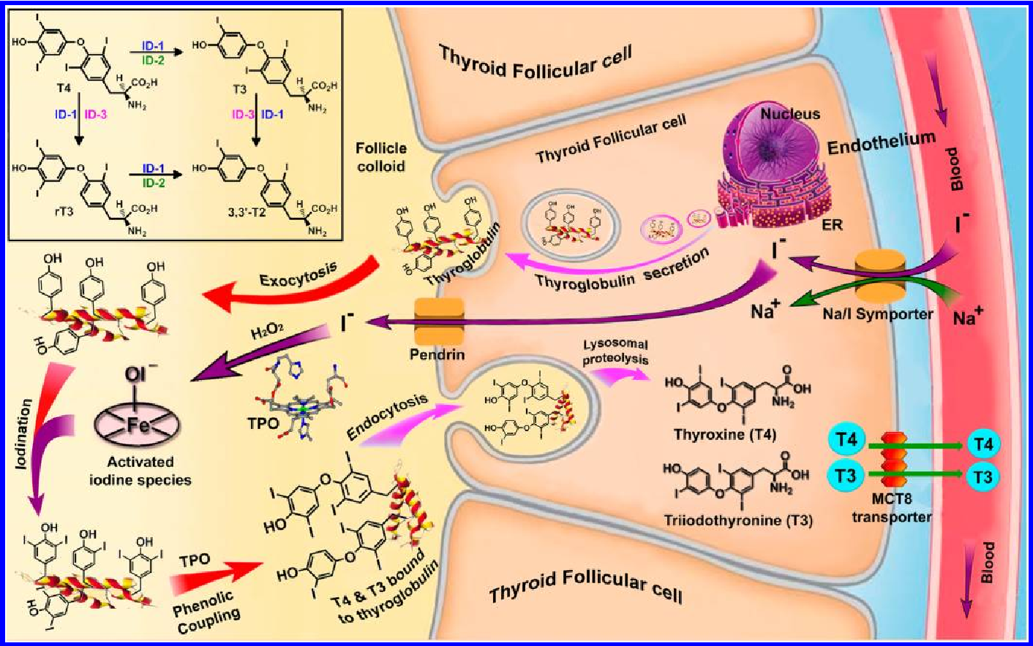

Slide 45
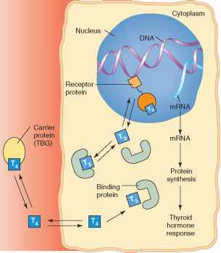
Mode of action of thyroid hormones

Slide 46
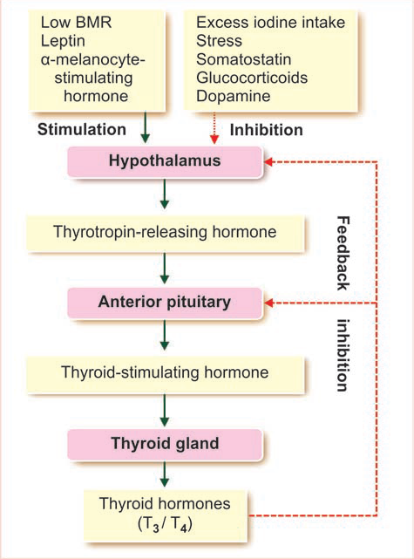
Regulation of secretion of thyroid hormones

Slide 47
Regulation of secretion of thyroid hormones
ROLE OF IODIDE
Important factor regulating the synthesis of thyroid
hormones.
Moderate level of iodine - the blood level of thyroid
hormones is normal.
High iodine level more than 2 mgl - suppression of hormone synthesis. (affects organifiaction)
Enzymes necessary for synthesis of thyroid
hormones are inhibited by iodide itself.
This effect of iodide is called Wolff-Chaikoff effect.

Slide 48
DISEASES OF THE THYROID GLAND
Thyroid hormones can be either deficient or excessive
– hypothyroidism or hyperthyroidism.
Hyperthyrodism
Cause:
Grave’s disease
Thyroid solitray toxic adenoma and toxisc multinodular goiter
Pituitary tumor
Iatrogenic

Slide 49
HYPERTHYROIDISM
Most common cause – Grave’s disease
Autoimmune disease where thyroid-stimulating immunoglobulin (TSI) is produced erroneously
Is not subject to the negative feedback mechanism

Slide 50
HYPERTHYROIDISM
Symptoms:
BMR is ↑, more heat is produced → ↑body temperature
Skin is hot and flushed
Increased sweating due to vasodilatation
Increased glucose production in the liver, rapid
absorption of glucose through the intestines, and
increased insulin resistance
Decreased body weight due to fat mobilization
Muscular weakness because of excess protein
catabolism and fat stores, decreased serumcholesterol

Slide 51
HYPERTHYROIDISM
Appetite increase but weight falls
Movements of digestive tracts are ↑ → diarrhea
Heart and respiratory rates ↑
↑ BP and P ulse r ate
A fine muscular tremor and nervousness are marked.
Person becomes excitable, irritable and apprehensive
Weakness of proximal muscles due to increased breakdown of muscle protein
Menstrual abnormalities like oligomenorrhea or amenorrhea occur

Slide 52
Symptoms:
Exophthalmos → complex water-retaining carbohydrate are deposited behind the eye → fluid retention pushes eyeballs forward (prominent feature of Grave’s disease only).
Treatment for hyperthyroidism is anti- thyroid drugs.

Slide 53
UNDERACTIVITY OF THYROID
Decreased secretion of thyroid hormones is
called hypothyroidism
Hypothyroidism leads to Myxedema in
adults and cretinism in children.

Slide 54
Cretinism
Cretinism occurs due to
Congenital absence of thyroid gland
Maternal iodine deficiency and maternal hypothyroidism
Lack of iodine in the diet.

Slide 55
Cretinism
Few weeks after birth signs develops
Sluggish movements
Croaking sound while crying
Skeletal growth is more affected than the
soft tissues.
Delay in epiphysial closure of limbs ,limbs are
short compared to trunk
So, there is stunted growth with bloated body.

Slide 56
Cretinism
The tongue becomes so big that it hangs
down with dripping of saliva.
The big tongue obstructs swallowing and
breathing.
The tongue produces characteristic guttural
breathing that may sometimes choke the
baby.

Slide 57
Cretinism
Infantile brain-small and under devloped brain
Deficiency after birth upto 2 years-defective
myelination
Branching and development of dendrites
decreases and abnormal synapse
Reduction in vascular bed to the brain
Critical period – one year
After 2 years deficiency –cretinism can be reversed

Slide 58
Part of brain mainly affected
Cerebral cortex ,basal ganglia and cochlea

Slide 60
Prevention
Administration of iodine to mother during pregnancy

Slide 61
Myxedema
Myxedema is the hypothyroidism in adults, characterized by generalized edematous appearance.
Causes
Diseases of thyroid gland-Autoimmune disease
Genetic disorder
Iodine deficiency
Deficiency of thyroid-stimulating hormone or
thyrotropin-releasing hormone.

Slide 62
Myxedema
Swelling of the face with periorbital oedema
Bagginess under the eyes
Non-pitting type of edema
Normally skin contain proteins combine with
mucoploysacharides ,hyaluronic acid and
chondroitin sulphuric acid
In hypothyroidism these complex deposits
under the skin leads to retention of water
and Nacl

Slide 63
Atherosclerosis
Dry thickened rough and yellow skin
Coarsening and loss of scalp hair
Low BMR, Hypersensitive to cold, low voltage ECG, hoarseness of voice, psychosis, memory loss, increase in S.Cholesterol

Slide 64
HYPOTHYROIDISM
Symptoms:
↓ overall metabolic activity, including ↓ BMR
Poor tolerance of cold → lack of calorigenic effect
Easily fatigue → lower energy production
Tendency to gain weight → not burning fuel at a normal rate

Slide 65
HYPOTHYROIDISM
Increases cholesterol level
T4-increase synthesis and increases
breakdown of cholesterol by increasing
LDL receptors in liver
Excretion of cholesterol more prominent
Increases Triglycerides and phospholipids

Slide 66
T4 necessary for hepatic conversion of
betacarotene to vitamin A and then to
retinine
Deficiency-carotenemia-yellowish
discloloration of skin
Sclera not stained yellow

Slide 67
HYPOTHYROIDISM
Heart and respiratory rates and BP reduced.
Gut movements sluggish →constipation
Mental effects including loss of intellectual function↓ alertness, slow speech and poor memory.

Slide 68
Mental and Physical lethargy
Electrical activity of brain decreases
PNS
Kneejerk reaction time increases
Normal -20msec

Slide 69
HYPOTHYROIDISM
Anemia
Extreme somnolence with sleeping up to 14
to16 hours per day
Depressed hair growth
Scaliness of the skin
Frog-like husky voice

Slide 70
Menorrhagia and polymenorrhea
Lactation-T4 necessary for galactopoesis

Slide 71
Hashimoto’s thyroiditis
Autoimmune thyroiditis
Antibodies against thyroglobulin and thyroid peroxiadase

Slide 72
HYPOTHYROIDISM
Generically, treatment consist of replacement therapy:
Thyroid hormone
Iodine

Slide 73
PHYSIOLOGICAL EFFECTS OF THYROID HORMONES

Slide 74
Goiter
Enlargement of
thyroid gland
May occur in
hypothyroidism and
hyperthyroidism-
but does not need to
be present in either
conditions

Slide 75
Goiter
Goiter in hyperthyroidism-Toxic goiter
Goiter in hypothyroidism- Non-toxic goiter
Endemic colloid goiter- iodine deficiency
Idiopathic non toxic goiter

Slide 76
Endemic colloid goiter- iodine deficiency
Iodine deficiency occurs when intake is less than 50
μg/day.
By feedback mechanism, hypothalamus and anterior
pituitary are stimulated.
It increases the secretion of TRH and TSH.
The TSH then causes the thyroid cells to secrete
tremendous amounts of thyroglobulin into the follicle.
As there are no hormones to be cleaved, the
thyroglobulin remains as it is and gets accumulated in
the follicles of the gland.
This increases the size of gland.

Slide 77
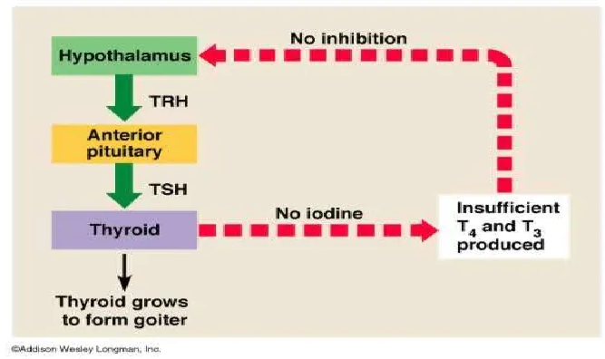
Pathogenesis

Slide 78
Pathogenesis of goitre
First stage
Enlargement of follicles –Colloid goitre
Hypertrophy and hyperplasia of follicular
epithelium, colloid decrease –
parenchymatous goitre
Tumor like mass of thyroid tissue-
Asymmetrical enlargement of gland-simple
adenomatous goitre

Slide 79
Idiopathic non-toxic goiter
Idiopathic non-toxic goiter is the goiter due
to unknown cause.
The exact cause is not known.
It may be due to thyroiditis and deficiency
of enzymes such as peroxidase, iodinase and deiodinase,which are required for thyroid hormone synthesis

Slide 80
Goitrogenic agents
Increased iodide
Monovalent ions such as perchlorate and thiocynate which block iodide pump
Perchlorate is an anion that occurs as a contaminant in groundwater. It originates from the improper disposal of ammonium perchlorate, a component of rocket fuel.
Cigarette smoke is the main source of thiocyanate, but it can also be found in some vegetables of the Cruciferae family, such as cabbage, broccoli and cauliflower.

Slide 81
Goitrogenic agents
Thiocarbamides (propylthyouracil) block the
coupling of iodine with tyrosine conversion
of T4 to T3
Vegetables of brussaciae family-goitrin-antithyroid agent

Slide 82
Thyroid function tests
BMR-oxygen consumption- +/-20%
Blood sugar
Increase in hyper
Decrease in hypo
S.Cholesterol –increase in hypo
Decrease in hyper
S.Creatinine –increase in hyper
decrease in hypo

Slide 83
Thyroid function tests
Based on handling of iodine
Protein bound iodine -3.5-7.5 microgm/dl
Radiocative iodine uptake
Serum thyroid hormones and TSH levels – one of the best tests to assess thyroid activity by radioimmunoassays

Slide 84
Thyroid function tests
TSH 0.2-5 IU/ml | T4 3-8 g/dl | T3 0.15g/dl | Interpretation
High | ↓ | ↓ | Hypothyroidism
Low | ↑ | ↑ | Hyperthyroidism

Slide 87
Thyroid function tests
Plasma level of T3 and T4 concentration of “free” thyroid hormones –more accurate

Slide 88
Thyroid function tests
Measurement of antibodies against thyroid
Thyroid suppression test
Thyroid stimulation test
Achilles Reflex time

Slide 89
Thyroid function tests
Ultrasound scan –differentiate cystic form from
solid form
CT and MRI – evaluation of retrosternal and
retrotracheal extension of the gland, compression
of trachea

Slide 90
USG and CT thyroid

Slide 91
THE END

